Slide 1
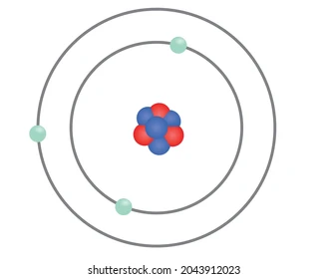
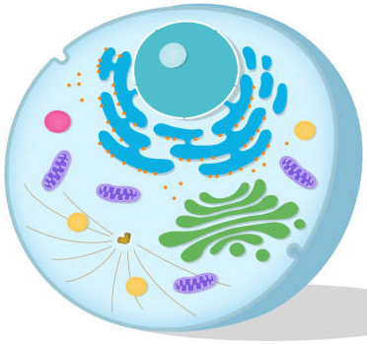

Chromosomes, genes and DNA
Textbook pages: 243 - 246
Lesson objectives
To explain what chromosomes are made up of.
To describe how characteristics are inherited.
To understand that more than one scientist was involved in discovering the structure of DNA.
Atoms and cells both contain a nucleus.
Why do you think these structures have the same name?
Keywords: nucleus, chromosomes, chromatid, centromere, genes, DNA, base sequences

Slide 2
Success Criteria
Working towards | Working at | Working beyond
I can describe the shape and structure of DNA including the complementary base pairs. | I can describe how DNA is arranged into genes and stored as 23 pairs of chromosomes in the nucleus of a human cell. | I can describe genes as short sections of DNA that code for proteins, which determine specific inherited characteristics
Chromosomes, genes and DNA

Slide 3
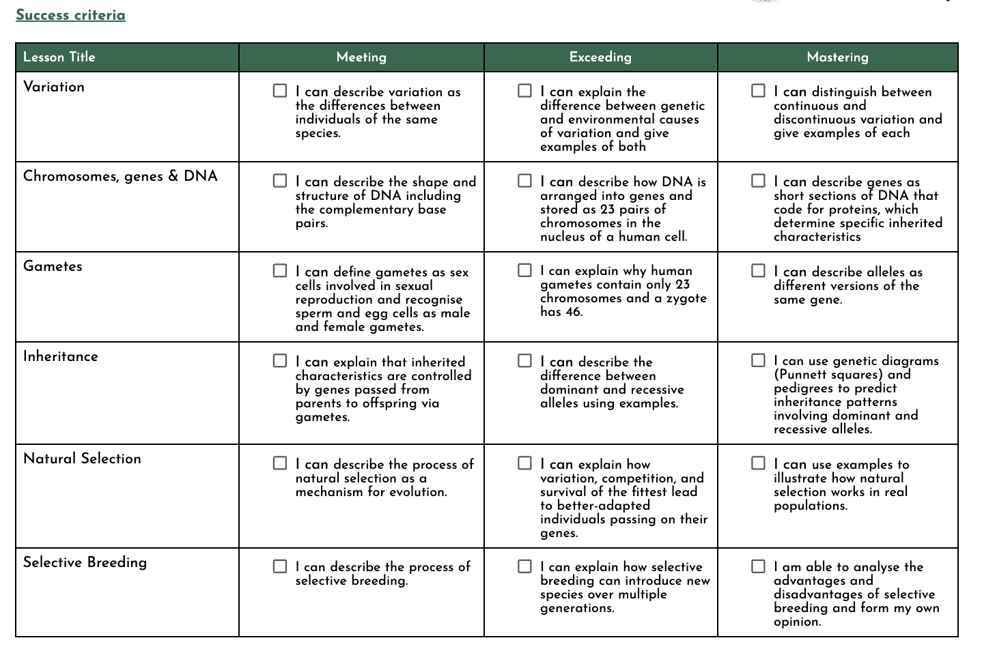

Slide 4
Nucleus
cell
nucleus
Both are in the centre of a large structure.
The nucleus of a cell is much, much larger than the nucleus of an atom - it controls the activities of the cell.
nucleus
atom

Slide 5
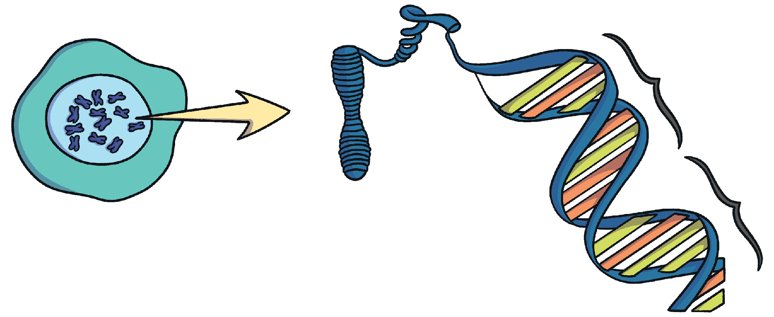
Nucleus
Chromosome
DNA
Gene
What do you know about these structures?

Slide 6
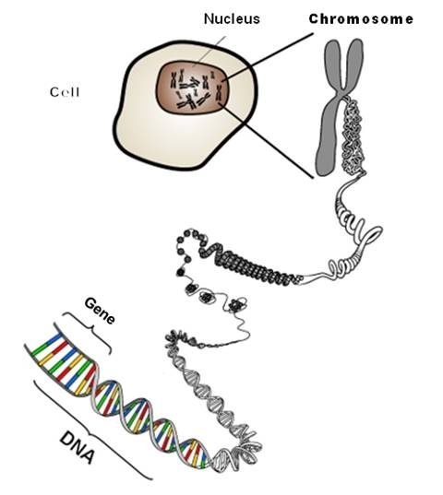
Human cells have 46 chromosomes (23 pairs)
Chromosome = long threads of DNA, found in the nucleus of a cell, which are made up of thousands of genes.
DNA = chemical substance that carries a code of instructions that determines how cells and organisms develop.
Gene = instructions, in the form of a DNA code, that affect many of the characteristics of an organism
Centromere
DNA contains all the instructions your body needs to live
Genes are the most basic unit of inheritance
Notes:
Every living thing contains DNA. It is the unique set of instructions that tells a seed how to grown into a plant or a baby into adult. Everyone’s DNA is different. DNA controls the colour of your eyes, skin and hair. DNA is wrapped tight inside the nucleus of every cell that builds a living thing. DNA is coiled tightly like thread and wrapped and squished into bundles that scientists called chromosomes.

Slide 7
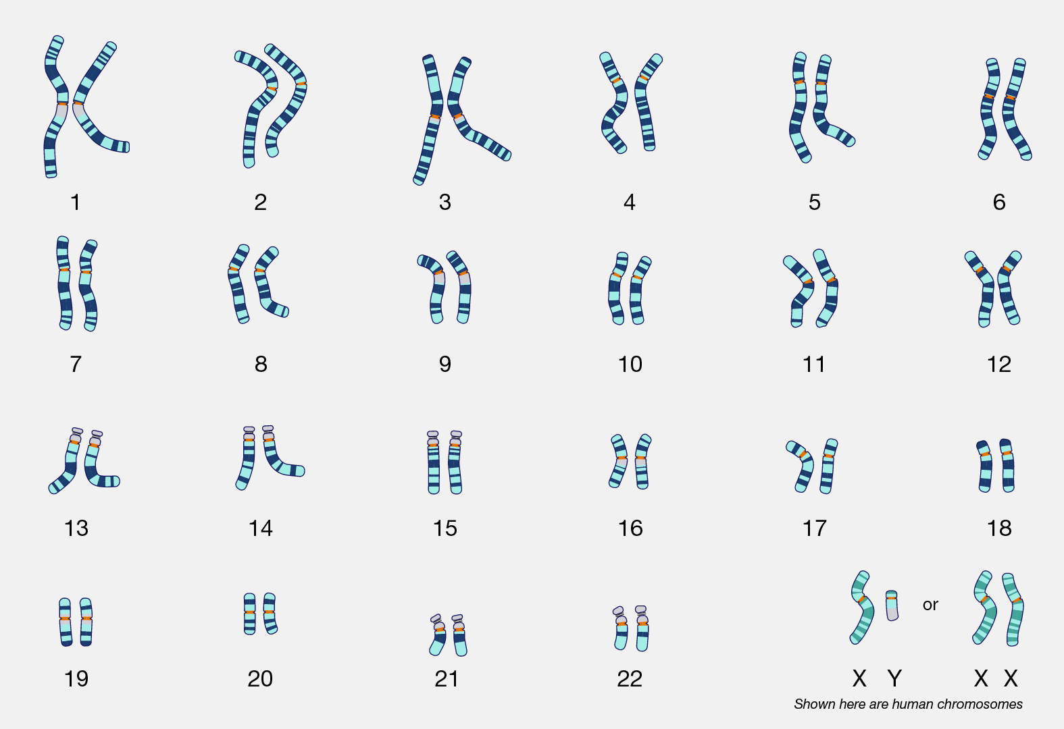

Slide 8
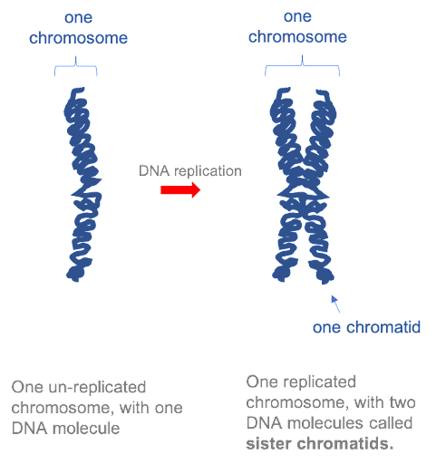
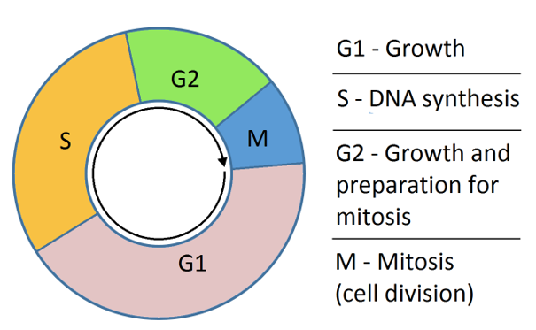
Chromosomes
We often see chromosomes having a ‘cross’ shape.
In reality, this is what a chromosome looks like when a cell has made a copy of itself, just before a cell divides.

Slide 9
Chromosomes
We often see chromosomes having a ‘cross’ shape.
In reality, this is what a chromosome looks like when a cell has made a copy of itself, just before a cell divides.
The two copies (chromatids) are joined together by their centromere.
centromere

Slide 10

Chromosomes, genes and DNA… continued
Lesson objectives
To explain what chromosomes are made up of.
To describe how characteristics are inherited.
To understand that more than one scientist was involved in discovering the structure of DNA.
STARTER: What are chromosomes made up of?
Keywords: nucleus, chromosomes, chromatid, centromere, genes, DNA, base sequences

Slide 11
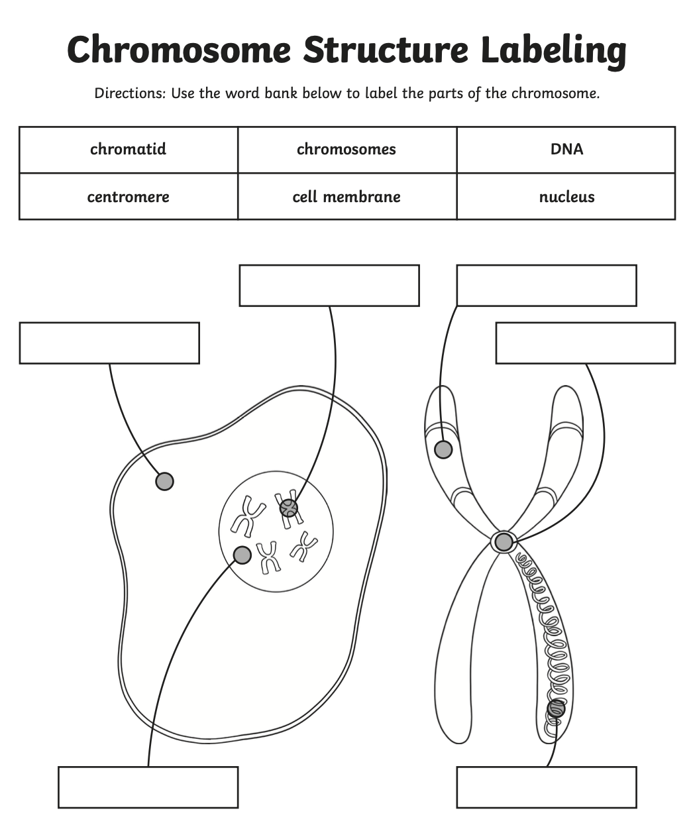

Chromosome structure
Next to/around the label, add the definition for each keyword.
Challenge: Write the definition, without looking at your notes!
Support: If English is not your first language, you are welcome to use your device to translate each label and write it next to it.
cell

Slide 12
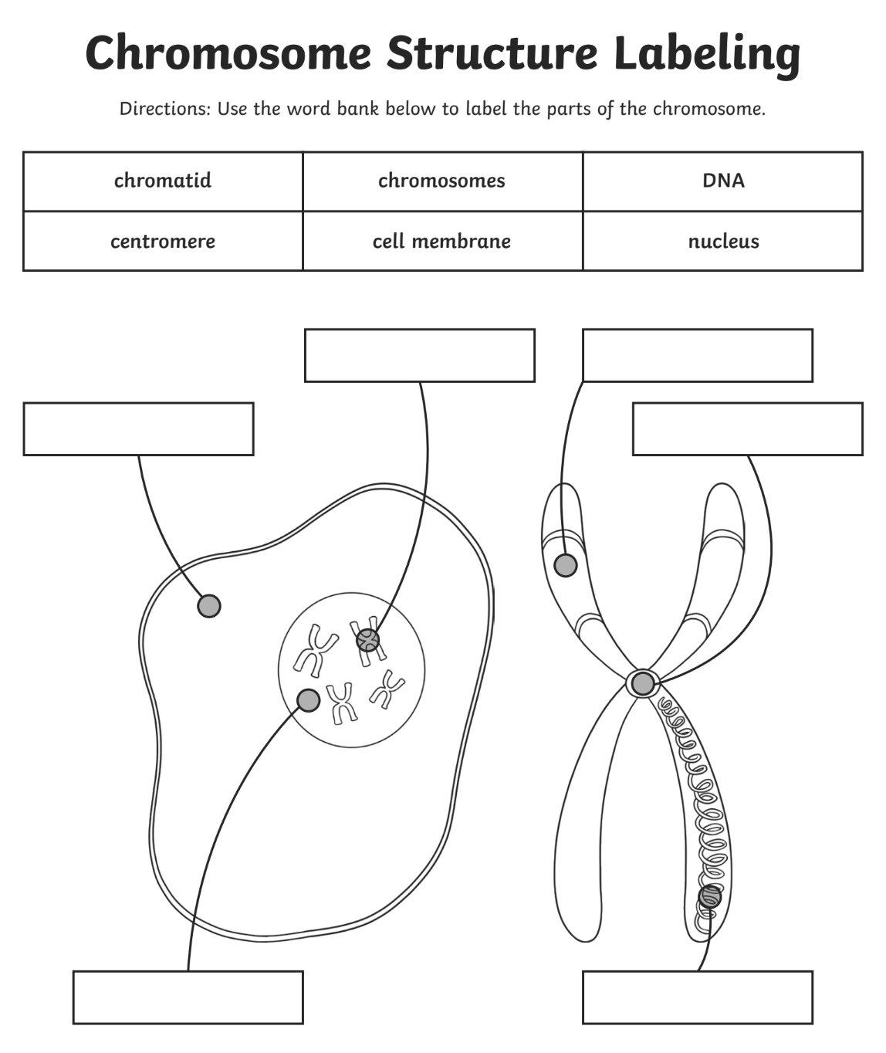
cell
cell

Slide 13
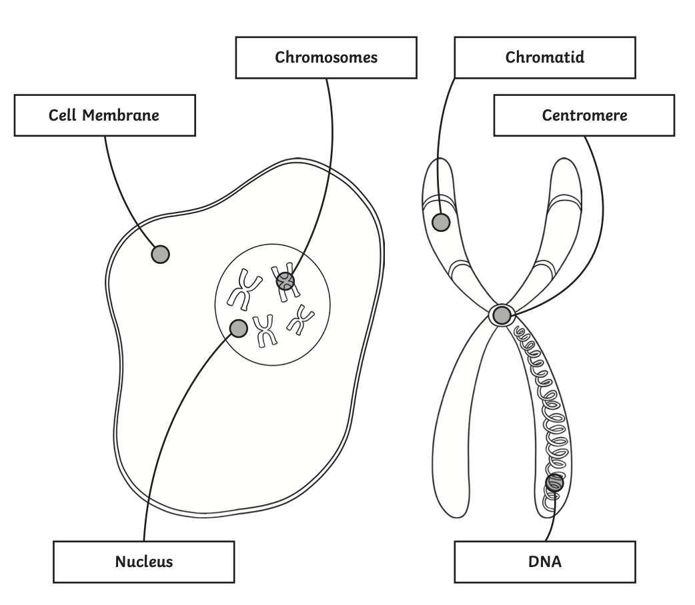


Chromosome structure
Cell: the smallest unit of life and the building blocks for all organisms
Nucleus: organelle that controls what happens in the cell
Chromosomes: long threads of DNA, found in the nucleus of a cell
Chromatid: one-half of a replicated chromosome
Centromere: structure that binds the two sister chromatids together
DNA: chemical substance that carries a code of instructions that determines how cells and organisms develop
Cell

Slide 14
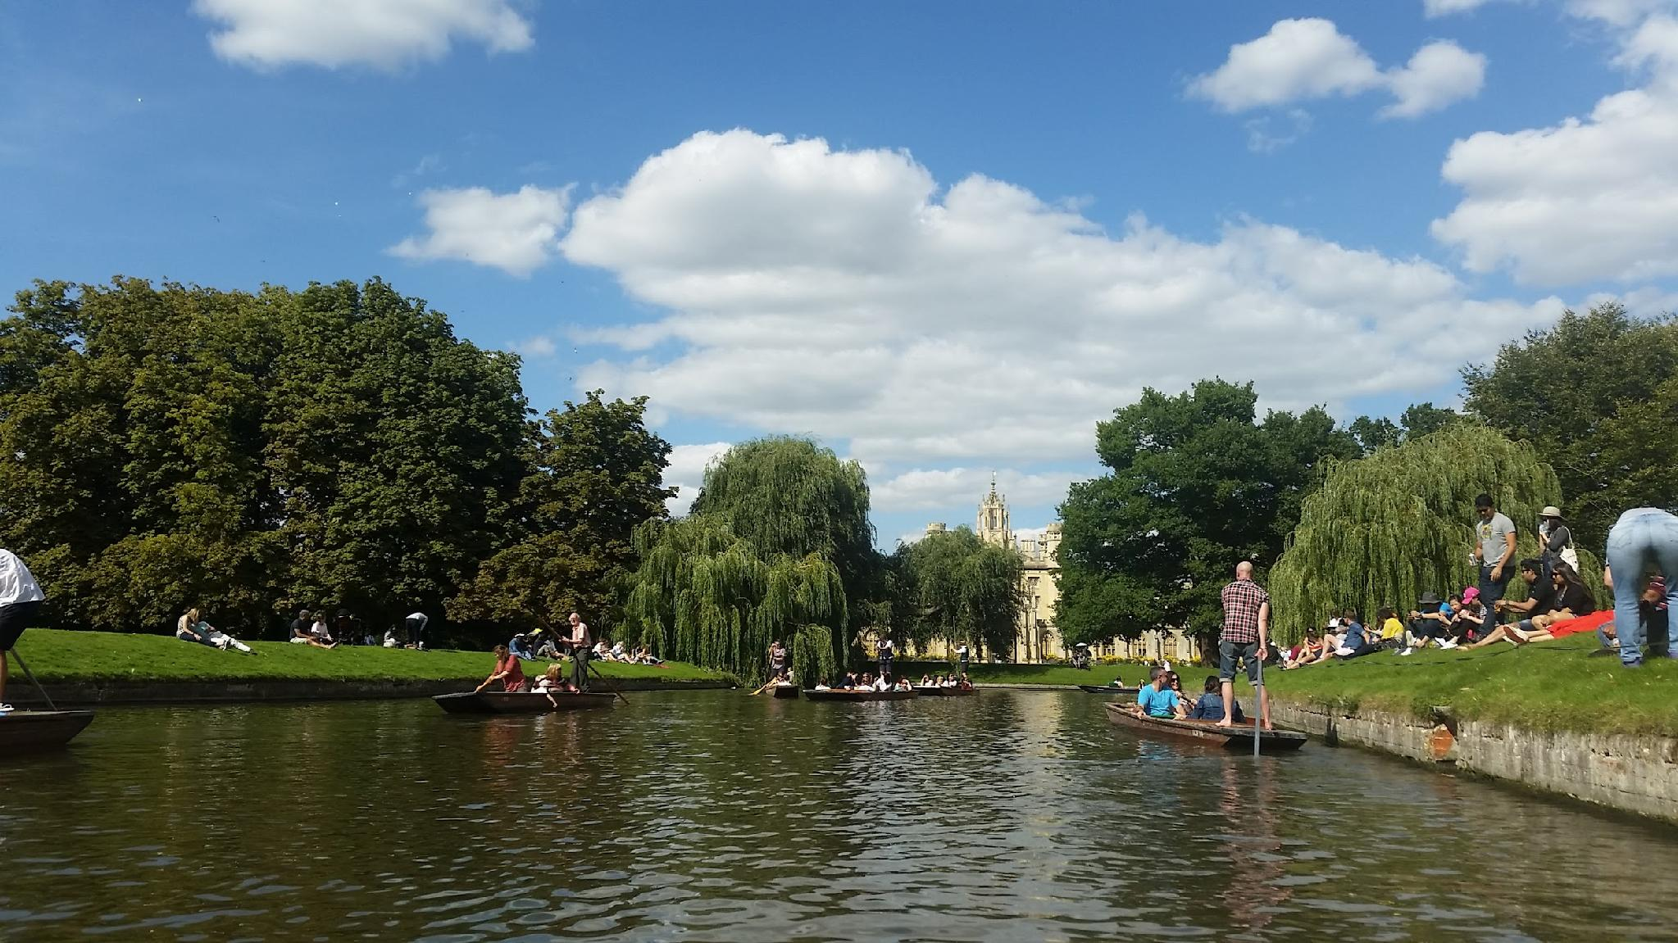
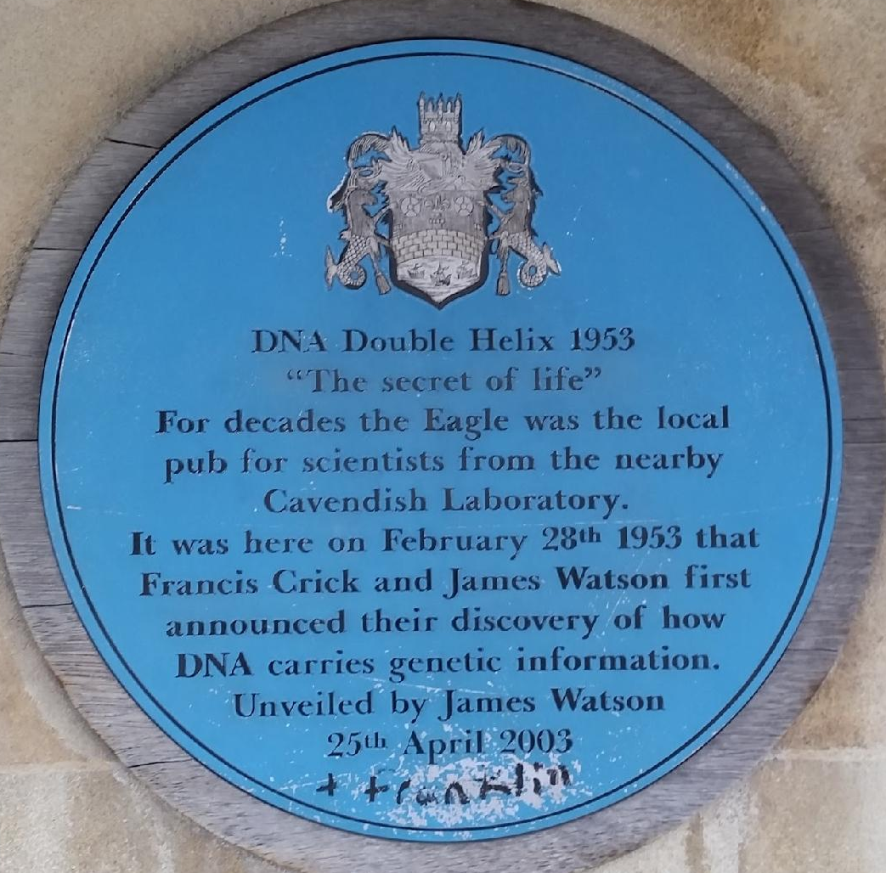
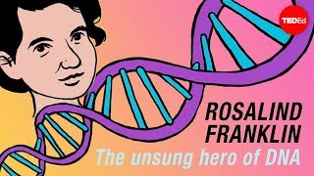
Franklin & Wilkins
Watson & Crick
Notes:
Over fifty years ago, Francis Crick walked into the Eagle pub and announced something for which he would later share a Nobel Prize

Slide 15
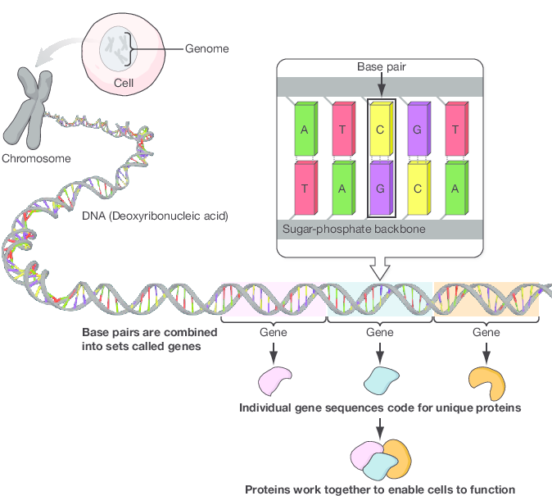
DNA and genes
Each chromosome is made up of a long tightly coiled DNA molecule.
The DNA twists into a double helix.
The DNA is made up of a sequence of bases - A, T, C and G. Only specific bases can pair up and bond with each other.
We call this complementary base pairing.

Slide 16
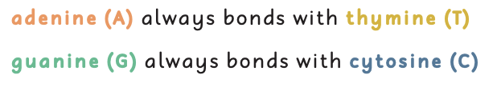
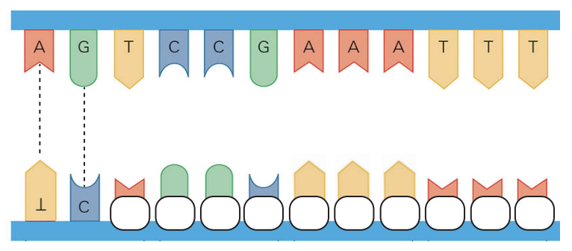
DNA and genes
Write down the missing base pairs in the boxes.

Slide 17
Notes:
TO PRINT

Slide 18
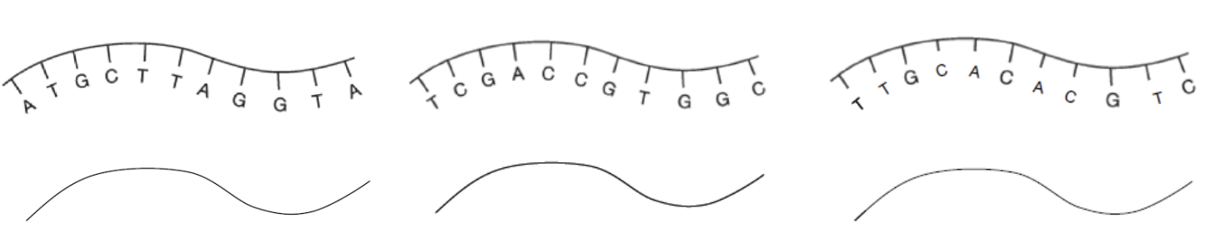
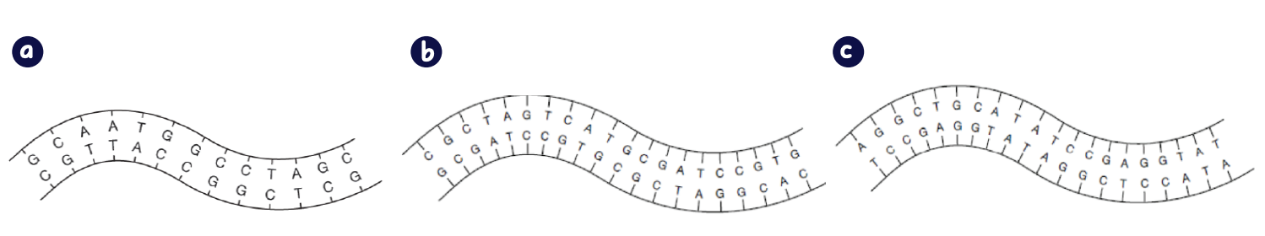
Most:
Draw the complementary DNA strand for the examples below.
Some:
Identify the mistakes by circling them in the following sections of DNA.

Slide 19
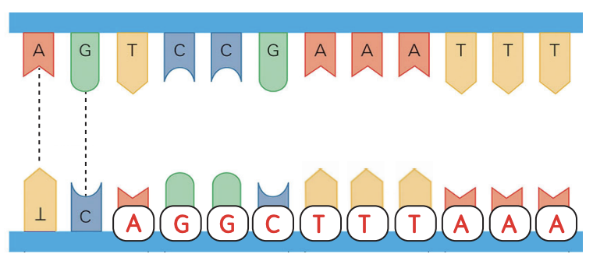
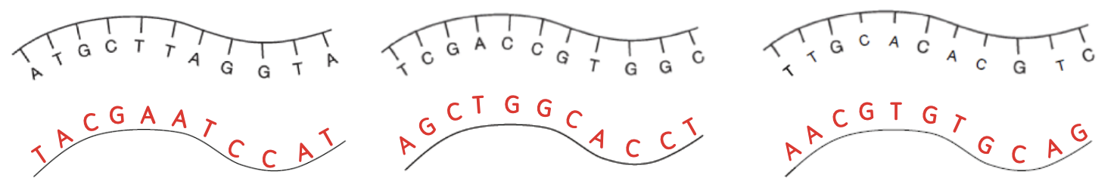
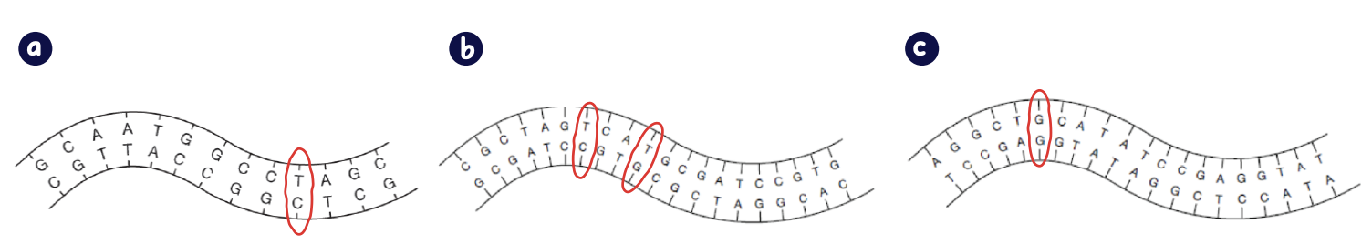

Slide 20
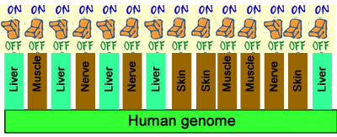
Every cell contains the same sequences of DNA!
Cells have specific proteins that help them perform their functions.
Genes can turn proteins off or on.
Proteins allow cells in different organs to look and act differently from each other.
An organism inherits its genes from its parents. This makes them unique.

Slide 21
Chromosomes, genes and DNA
All: Use modeling clay to create models of chromosomes, DNA, and genes. Use whiteboard pens to label the desk.
Most: Compare and contrast genes and chromosomes. Add brief notes and key words to complete the Venn diagram.
Genes
Chromosomes
Both
Some: Use the internet to research this question:
Do larger organisms have larger numbers of chromosomes in their cells?

Slide 22
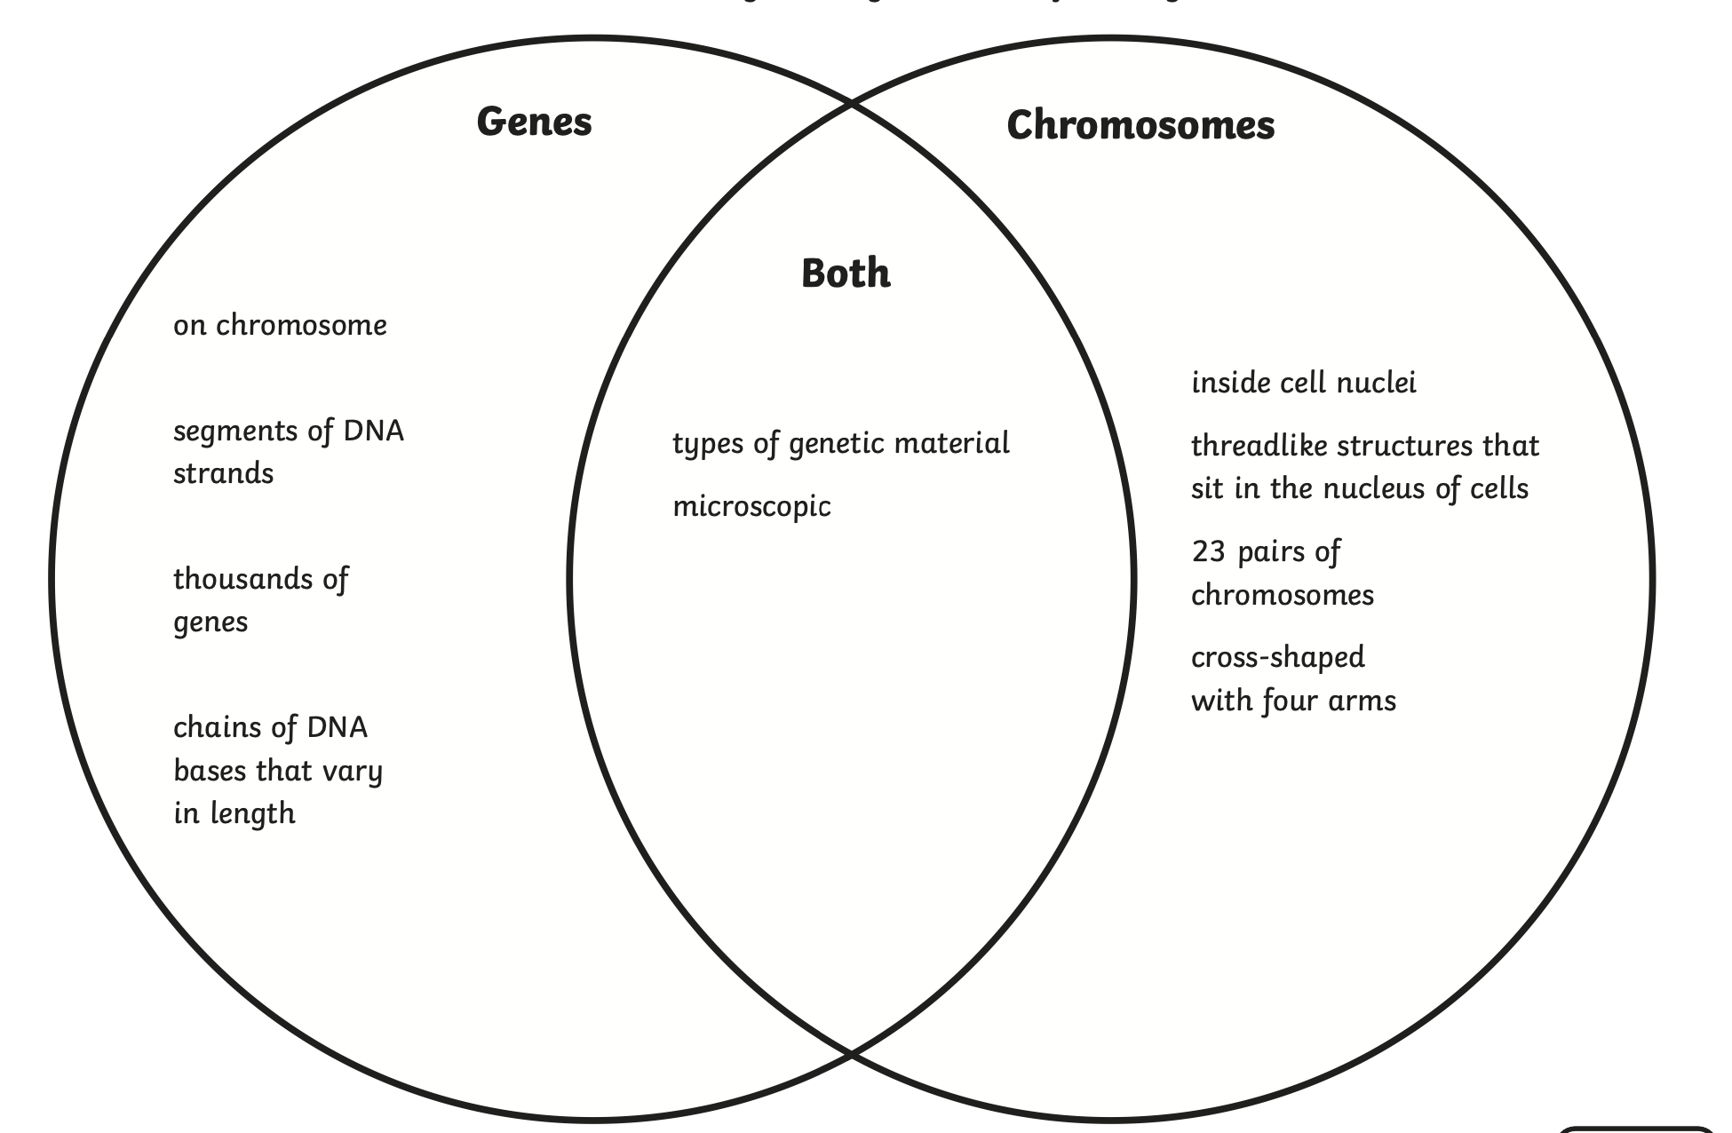
Genes vs Chromosomes
Answers will vary but may include the following

